Slide 1
BCA CAPSTONE PROJECT (Review III) Medication Reminder App
Submitted to the Presidency University, Bengaluru in partial fulfillment for the award of the degree of Bachelor of Computer Applications(BCA)
Project Team No : 78
Under the supervision of
Mr.Sakthi S Assistant Professor, School Of Computer Science And Engineering
Name | Roll Number
Pinjari Afsheen Misba | 20231BCD0025
Pinjari Ummi Salma | 20231BCD0026
Yashwini R | 20231BCD0037
Gifty Mary Charly | 20231BCD0046

Slide 2
Content
Project Overview
Modular design
Timeline of the Project
Github Link
Team Member Contributions
Future scope

Slide 3
Project Overview
Project Goal/Problem: The goal of this project is to develop a Medication Reminder App that helps users consistently manage their medication schedules. The app addresses the common problem of users forgetting to take their medication, which can lead to serious health risks. By offering timely reminders, adherence tracking, and caregiver integration, the app aims to improve user health outcomes and provide peace of mind for both users and their caregivers.
Scope: Within the boundaries of this project, we aim to achieve:
A mobile frontend built for user interactions.
A backend server built to handle user data, reminders, and caregiver communication.

Slide 4
Module Design
Modular Breakdown
Module 1: User Registration & Profile Management
Module 2: Reminder & Notification System
Module 3: Reporting
Module 4: Caregiver & Doctor Integration

Slide 5
Module Design(Cont)
Module 1: User Registration & Profile Management
Purpose:
This module handles user onboarding, ensuring each user has a personalized experience.
Key Features:
Sign-up/Login: Users can create accounts using email, phone numbers, or social media
Data Security: Implements secure password storage and data protection practices.
Why It’s Important:
Personalization of medication plans relies on accurate user data, making this module the foundation of the app.

Slide 6
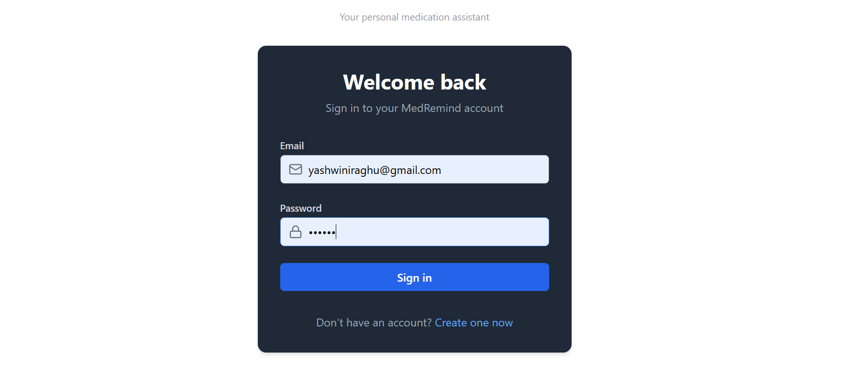

Slide 7
Module Design(Cont)
Module 2: Reminder & Notification System
Purpose:
This module schedules medication reminders and sends alerts to users.
Key Features:
Smart Reminders: Timely push notifications, SMS, or email alerts for medication intake.
Customization: Users can set reminder frequencies — daily, weekly, or custom intervals.
Snooze/Reschedule Options: Allows flexibility if users miss a reminder.
Why It’s Important:
Ensures users never forget their medication, enhancing adherence to treatment plans.

Slide 8
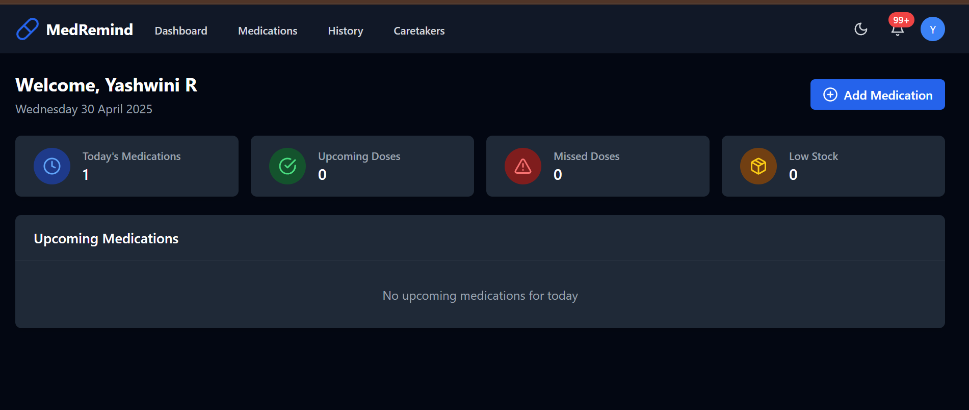

Slide 9
Module Design(Cont)
Module 3: Reporting
Purpose:
To monitor how consistently users follow their medication schedules and generate useful insights.
Key Features:
Logging System: Users confirm medication intake through the app.
Progress Reports: Visual dashboards showing adherence percentages.
Export Data: Generates PDF or CSV reports for personal use or medical reviews.
Why It’s Important:
Helps users stay accountable and allows doctors to review patient progress easily.

Slide 10
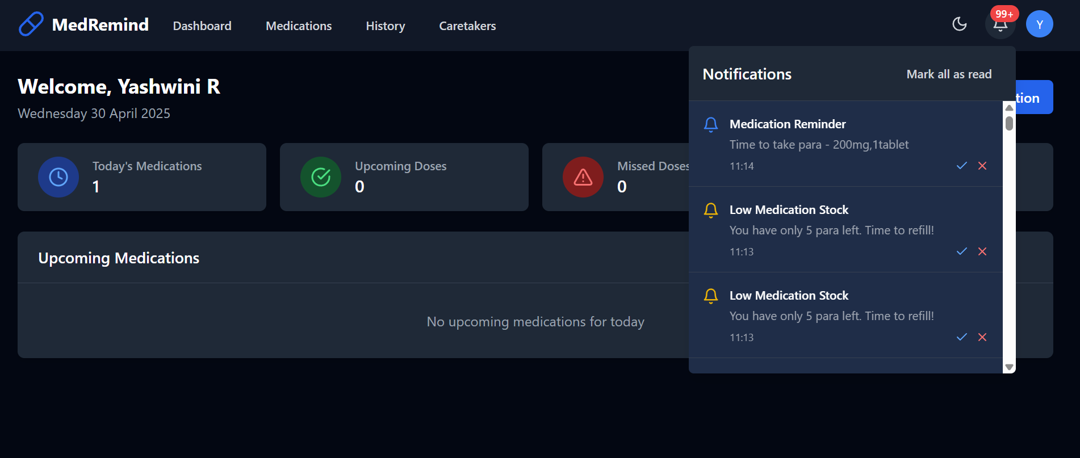
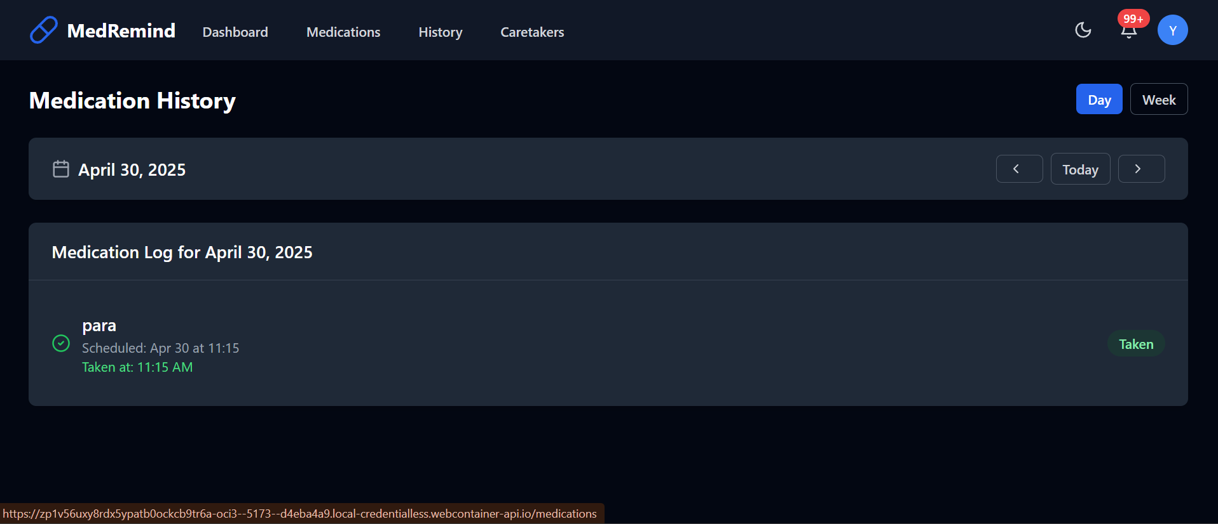

Slide 11
Module Design(Cont)
Module 4: Caregiver & Doctor Integration
Purpose:
Facilitates collaboration between users, caregivers, and healthcare providers.
Key Features:
Caregiver Access: Enables family members to receive notifications if a user misses a dose.
Why It’s Important:
Promotes a support system, ensuring users are not alone in their health journey.

Slide 12
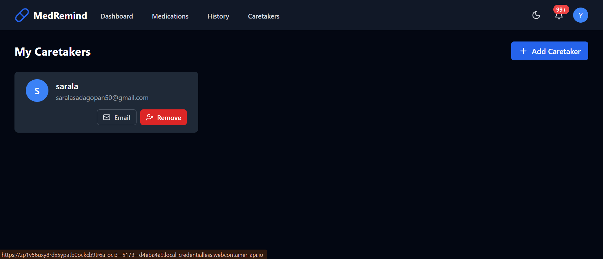
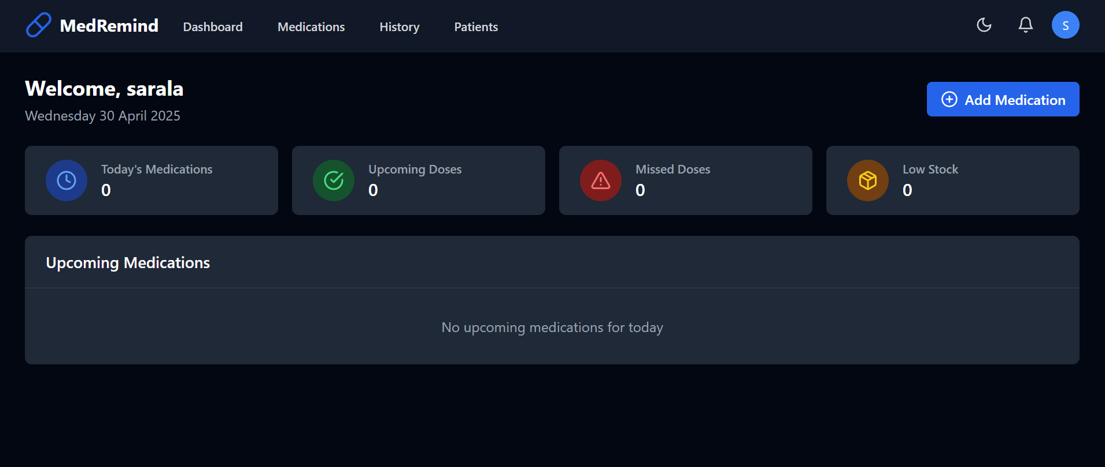

Slide 13
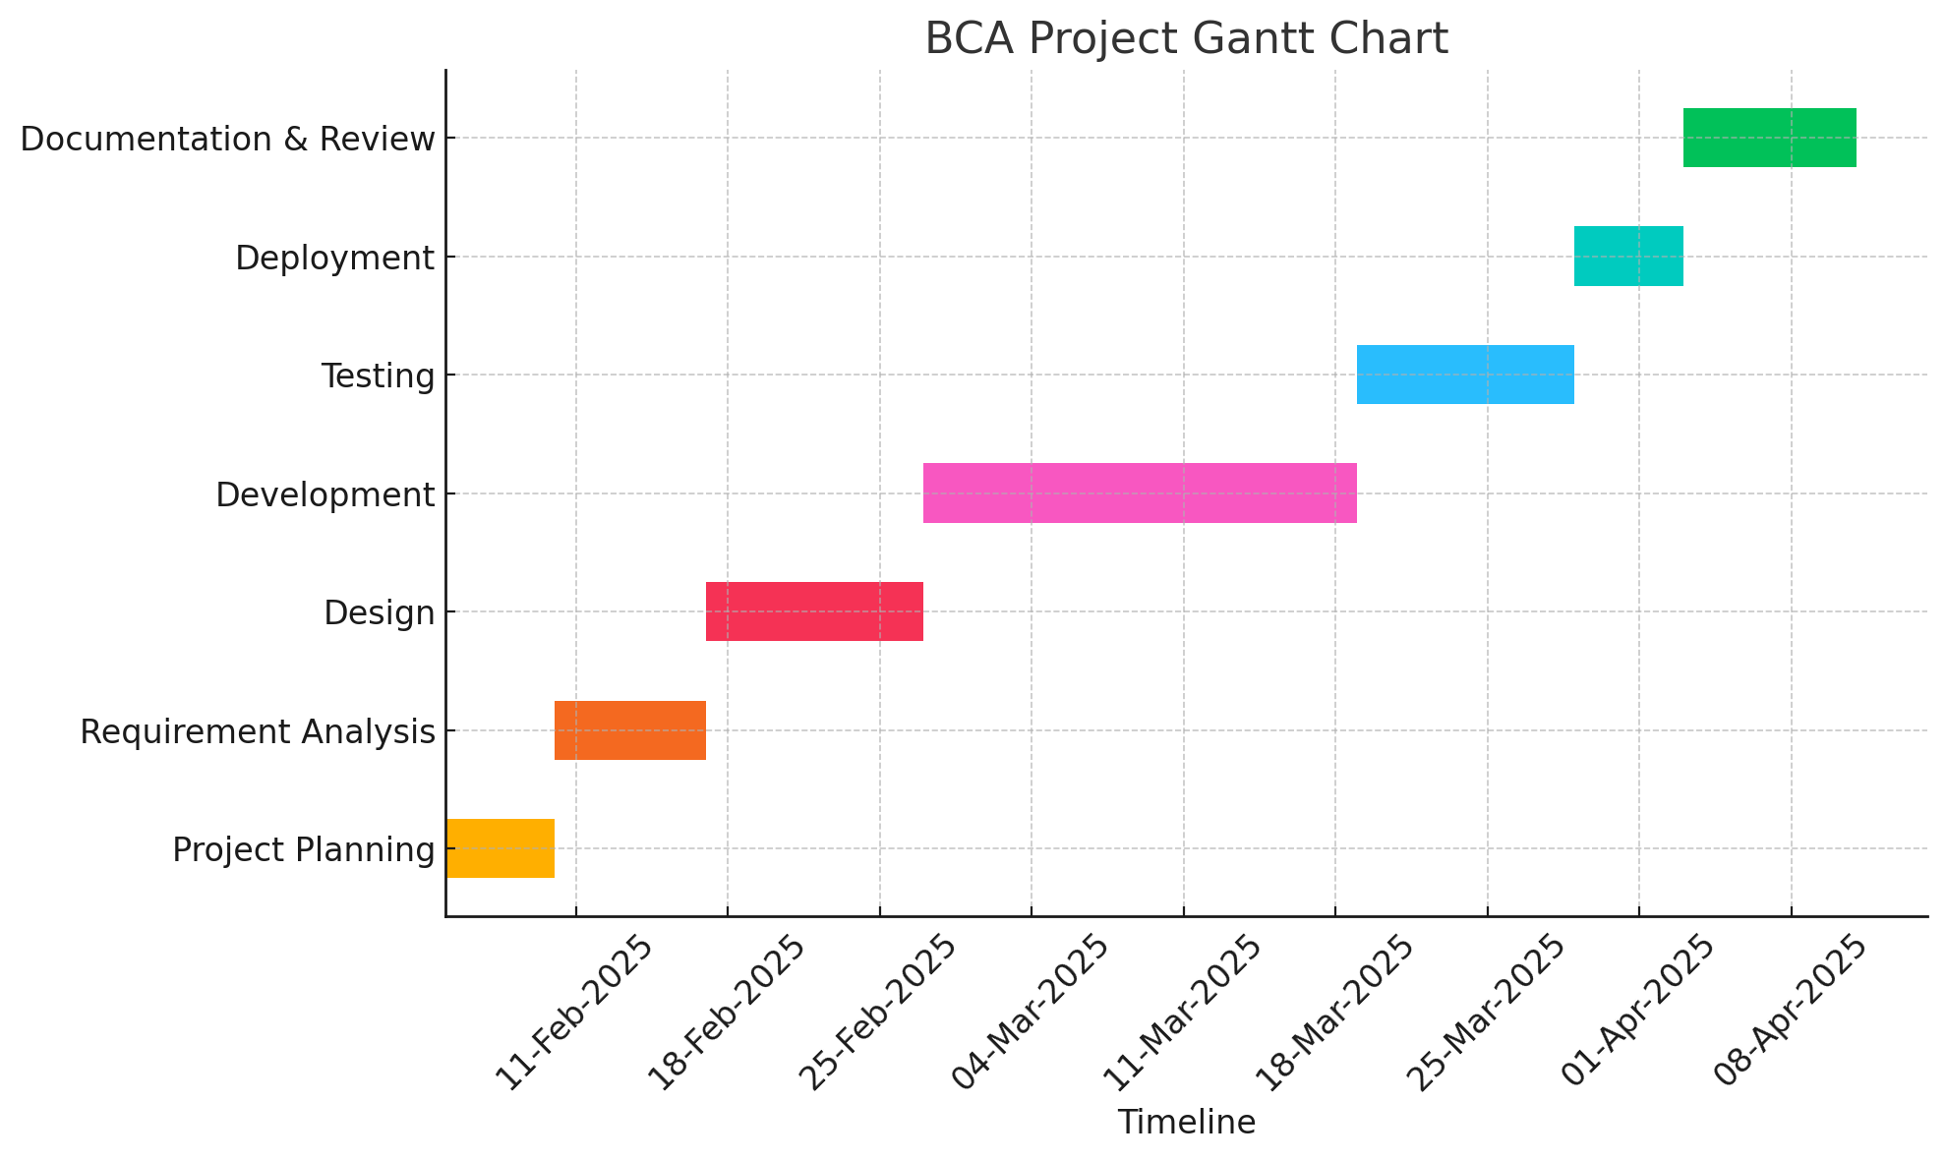
Timeline of the Project (Gantt Chart)

Slide 14
Github Link
https://github.com/Gift20032013/medicationreminderapp/upload/main

Slide 15
References
Name | Author Name | Year | About | Link
IOT-Based Real Time Medicine Reminder and Tracking System | Sangameshwar Kawdi, Preeti, Namratha, Vijay Laxmi | 2024 | Innovative solution to address medication non-adherence using IOT, multi-modal reminders, and customizable features. | https://www.irjet.net/archives/V11/i2/IRJET-V11I2117.pdf
GoMed: Daily Medicine Reminder Application | Afshaan Sarguroh, Munaf Shaikh, Kashif Khan, Dr. Zainab Mirza | 2021 | Android-based application with features like Medicine Reminder, Medicine Restocking Alert, BMI Calculator, and more to support medical adherence and improve health. | https://ijarcce.com/wp-content/uploads/2021/05/IJARCCE.2021.10441.pdf

Slide 16
References (Cont)
Name | Author Name | Year | About | Link
IOT-Based Medicine Reminder and Monitoring System for Safe Health | Khushboo Malvi, Kruti Bhardwaj, Prajwal Kokate, Dolly Rahangdale | 2022 | Smart healthcare system built on the IOT with a smart medication box, connected sensors, and servers for continuous health monitoring. | https://www.irjet.net/archives/V9/i12/IRJET-V9I12212.pdf
Med-X, Medicine Reminder App | Prafful Naikode, Poojal Pithwa, Lakshita Landge | 2021 | Android software that helps those who are forgetful or busy remember to take daily meds with customized profiles, auto tracking, and report generation. | https://ijrpr.com/uploads/V2ISSUE11/IJRPR1903.pdf

Slide 17
Future Scope
Advanced Notification System: Introduce smart alerts, snooze options, repeated notifications, and escalation if users consistently miss doses.
Medication Database Integration: Connect the app with official medication databases to allow users to easily find their prescribed drugs, with auto-filled dosage and instruction details.
Doctor and Pharmacy Connectivity: Allow users to share medication adherence data with doctors and receive updated prescriptions or medication changes directly through the app.
Multi-Language Support: Add support for various languages to make the app accessible to a broader global audience, including elderly users with limited English proficiency.
Wearable Device Integration: Sync the app with smartwatches and fitness trackers to deliver reminders and collect health data related to medication intake patterns.
Emergency Contact Alerts: Automatically notify a caregiver or emergency contact if a user misses critical medications or shows a pattern of non-adherence.

Slide 18
Team Member Contributions
Team Member | Contribution
Gifty Mary Charly | Frontend
Yashwini R | Backend
Pinjari Ummi Salma | Testing
Pinjari Afsheen Misba | Integration

Slide 19
Conclusion
This project aims to enhance medication adherence with a smart reminder system.
AI and real-time monitoring set it apart from existing solutions.
The use of modern technologies ensures scalability and efficiency

Slide 20


